Slide 1



Electrolytic Application of Load-Managing Photovoltaic System
Christian Polo
Arizona NASA Space Grant Consortium Symposium
April 17, 2021

Slide 2
Problem
Solar energy still needs to improve its efficiency
Use of maximum power point trackers (MPPT) to transfer power from solar panel module wastes power
Energy storage solutions for solar energy have been mostly focused on batteries

Slide 3
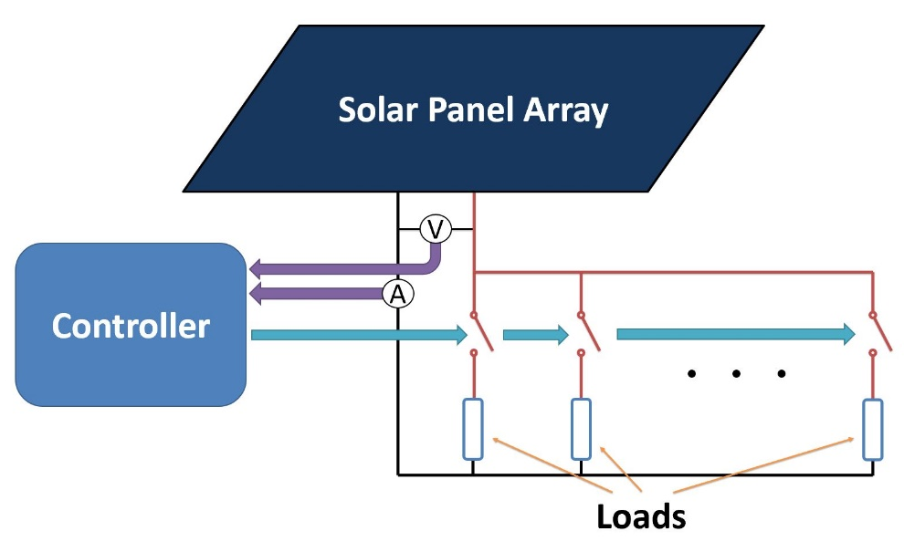
Intro to Load-Managing System (LMPV)
Varies the number of loads connected
Has had success in transfer efficiency of up to 99% with resistive loads
Physical prototype system current in place

Slide 4
Objective of the project
Optimizing power transfer using electrolyzers in LMPV system
  Goal is to follow the maximum power curve throughout the day
Implementing system for the sustainable production of hydrogen

Slide 5
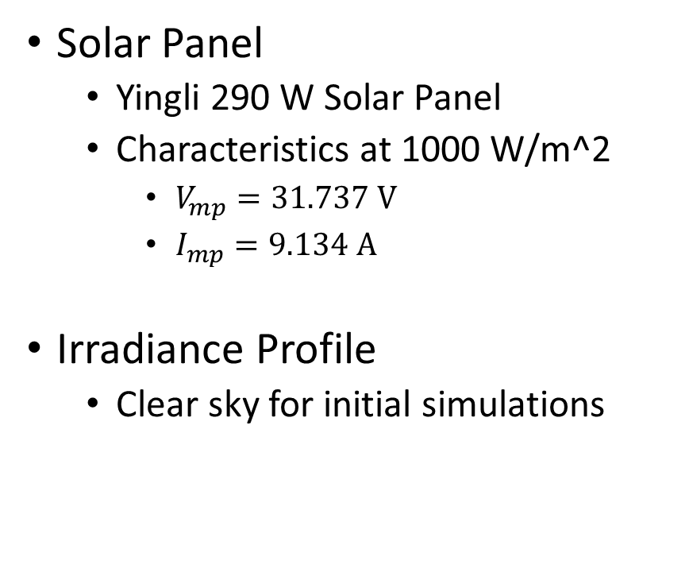
Solar Panel Module and Irradiance Profile
Solar Panel
  Yingli 290 W Solar Panel
  Characteristics at 1000 W/m^2
    $V_{mp}=31.737 V$
    $I_{mp}=9.134 A$
Irradiance Profile
  Clear sky for initial simulations

Slide 6

Methods and Analysis Techniques
Hand Calculations and derivations
MATLAB and Simulink
Spice Simulations
Physical Validation

Slide 7
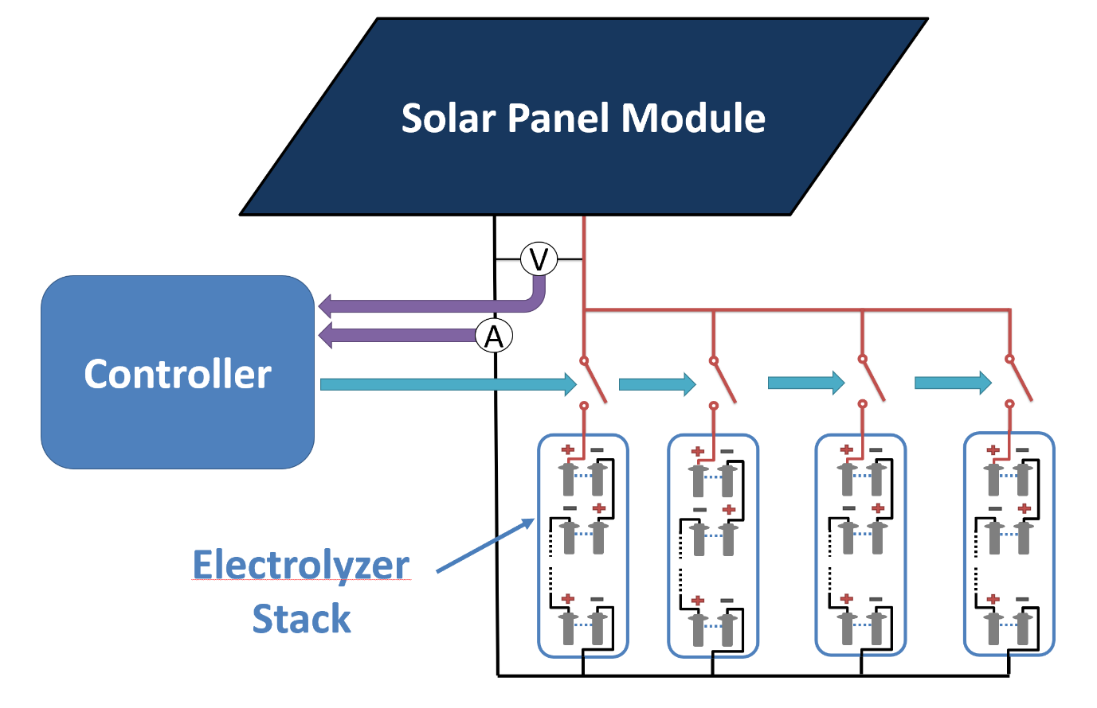
Electrolytic Load Design
LMPV loads are stacks of electrolytic cells in series
Model derived from data provided by NEL Hydrogen for a single electrolytic cell
Simulation and physical models use diodes and resistors to model electrical behavior

Slide 8
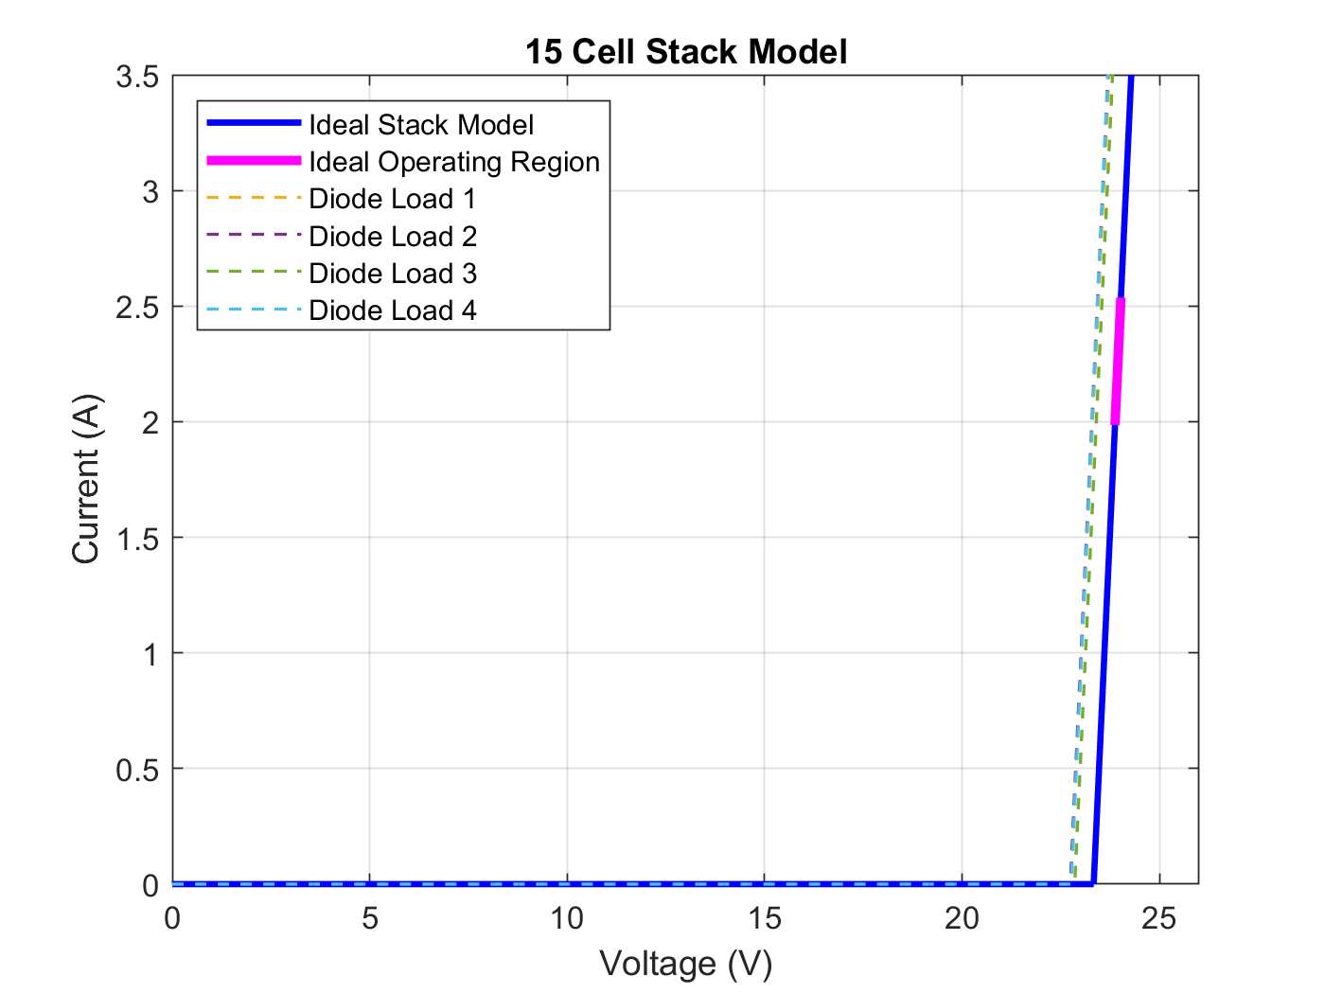
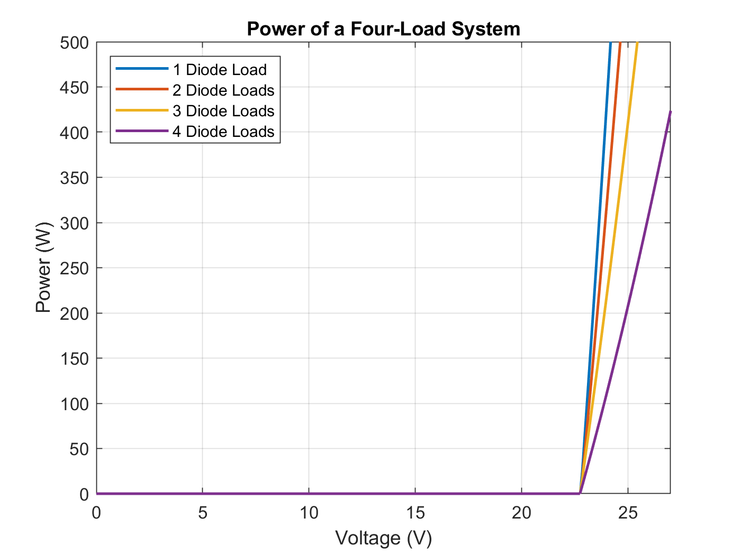
Electrolytic Load Design

Slide 9
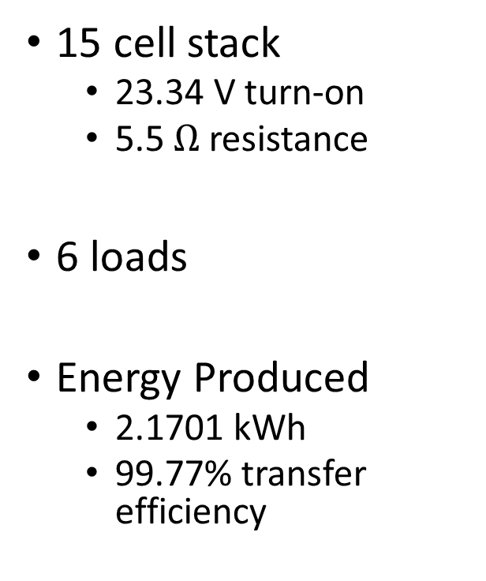
Simulation for Electrolytic Stack
15 cell stack
  23.34 V turn-on
  5.5 $Ω$ resistance
6 loads
Energy Produced
  2.1701 kWh
  99.77% transfer efficiency

Slide 10
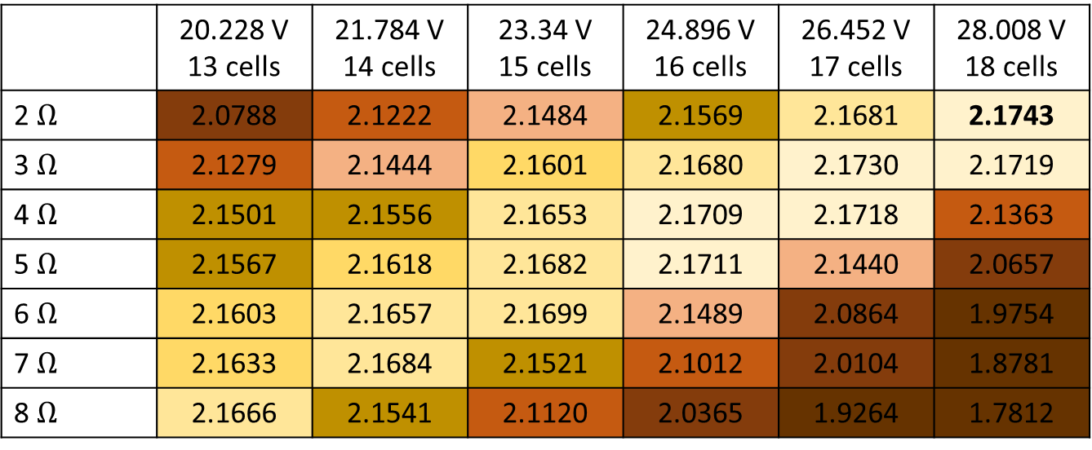
Transfer for different stack configurations
 | 20.228 V 13 cells | 21.784 V 14 cells | 23.34 V 15 cells | 24.896 V 16 cells | 26.452 V 17 cells | 28.008 V 18 cells
2 $Ω$ | 2.0788 | 2.1222 | 2.1484 | 2.1569 | 2.1681 | 2.1743
3 $Ω$ | 2.1279 | 2.1444 | 2.1601 | 2.1680 | 2.1730 | 2.1719
4 $Ω$ | 2.1501 | 2.1556 | 2.1653 | 2.1709 | 2.1718 | 2.1363
5 $Ω$ | 2.1567 | 2.1618 | 2.1682 | 2.1711 | 2.1440 | 2.0657
6 $Ω$ | 2.1603 | 2.1657 | 2.1699 | 2.1489 | 2.0864 | 1.9754
7 $Ω$ | 2.1633 | 2.1684 | 2.1521 | 2.1012 | 2.0104 | 1.8781
8 $Ω$ | 2.1666 | 2.1541 | 2.1120 | 2.0365 | 1.9264 | 1.7812
Energy in kWh
 | 2.170-2.175
 | 2.165-2.170
 | 2.160-2.165
 | 2.150-2.160
 | 2.140-2.150
 | 2.100-2.140
 | 2.000-2.100
 | <2.000

Slide 11
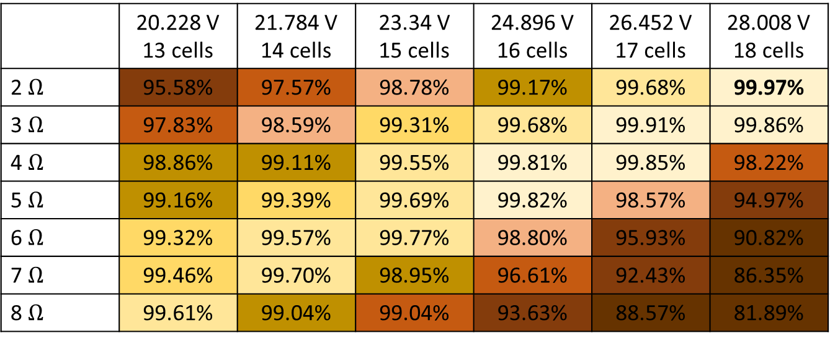
Efficiency for different stack configurations
 | 20.228 V 13 cells | 21.784 V 14 cells | 23.34 V 15 cells | 24.896 V 16 cells | 26.452 V 17 cells | 28.008 V 18 cells
2 $Ω$ | 95.58% | 97.57% | 98.78% | 99.17% | 99.68% | 99.97%
3 $Ω$ | 97.83% | 98.59% | 99.31% | 99.68% | 99.91% | 99.86%
4 $Ω$ | 98.86% | 99.11% | 99.55% | 99.81% | 99.85% | 98.22%
5 $Ω$ | 99.16% | 99.39% | 99.69% | 99.82% | 98.57% | 94.97%
6 $Ω$ | 99.32% | 99.57% | 99.77% | 98.80% | 95.93% | 90.82%
7 $Ω$ | 99.46% | 99.70% | 98.95% | 96.61% | 92.43% | 86.35%
8 $Ω$ | 99.61% | 99.04% | 99.04% | 93.63% | 88.57% | 81.89%
Energy in kWh
 | 2.170-2.175
 | 2.165-2.170
 | 2.160-2.165
 | 2.150-2.160
 | 2.140-2.150
 | 2.100-2.140
 | 2.000-2.100
 | <2.000

Slide 12
Efficiency for different stack configurations

Slide 13
Insights and significance
Results show a diagonal of optimal values with a peak toward the top right corner with a large turn-on voltage and small resistance
Region with more consistent output is more favorable with a real system with variable conditions.
Results show that the control system can be successfully generalized from resistive loads to electrolytic loads

Slide 14
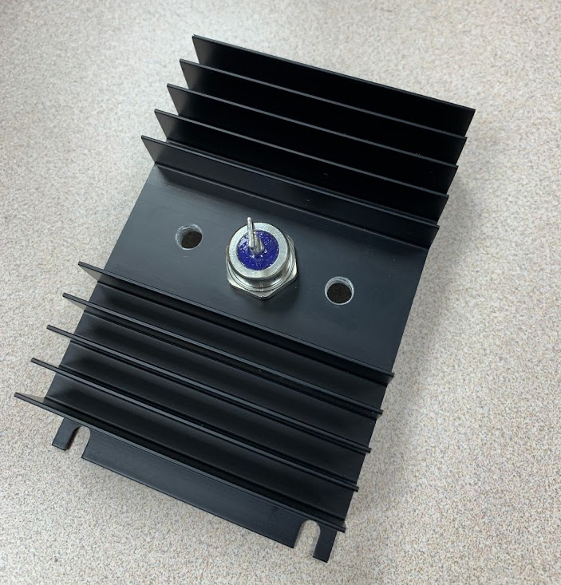
Steps Moving Forward
Use the diode stacks to physically test the LMPV design
Derive and model hydrogen output of the system
Expand the model to larger systems for demonstration and possible testing

Slide 15
Acknowledgements
NEL Hydrogen
Joseph Azzolini
William Parquette
Kelvin Tan
Arizona/NASA Space Grant Consortium
The material contained in this document is based upon work supported by a National Aeronautics and Space Administration (NASA) grant or cooperative agreement. Any opinions, findings, conclusions or recommendations expressed in this material are those of the author and do not necessarily reflect the views of NASA. This work was supported through a NASA grant awarded to the Arizona/NASA Space Grant Consortium.

Slide 16
Questions?

